Slide 2
Notes:
Teacher notes
In ‘Slide Show’ mode, click the name of a section to jump straight to that slide.

Slide 3

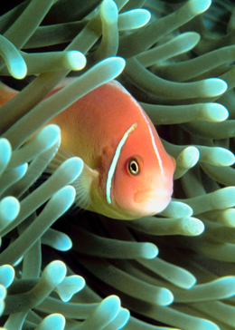

Exchange surfaces
All organisms require nutrients and the ability to excrete waste. Many simple organisms, such as bacteria and sea anemones, can exchange substances directly across their external surfaces.
Larger organisms require specialized gas exchange and transport systems to transport substances such as oxygen and nutrients to their cells efficiently.
Fish exchange these substances across gills, while insects have openings called spiracles on their surfaces.
Crop photo
In mammals, gas exchange occurs in the lungs, and in particular the alveoli.

Slide 4
EFFECTIVE GAS EXCHANGE
●A large surface area
●Thin layers
●a rich blood supply
●Moist surfaces because diffusion takes place with the gases in solution.
●Permeable surfaces

Slide 5

Structure of the lungs

Slide 6
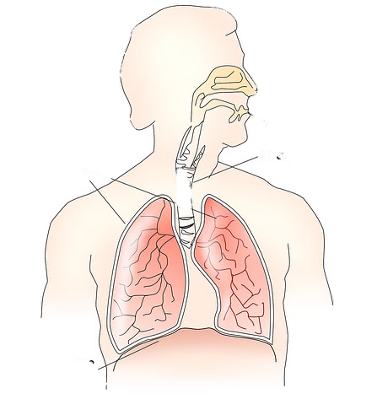
2g – Gas exchange - Humans
Structure of the thorax
Lungs肺
Trachea气管
Pleural membranes胸膜
Ribs肋骨
Bronchi支气管
Bronchiole细支气管
Intercostal muscles肋间肌
Alveoli肺泡
Diaphragm膈

Slide 7


The Gaseous Exchange System
Copyright © 2014 Henry Exham
Structure | Function
Trachea | Tube with incomplete rings of cartilage carries air to lungs; lined with cells making mucus, and cells with cilia to move the mucus away.
Bronchi | Carry air to lungs
Bronchioles | Carry air to lungs
Alveoli | Tiny air sacs adapted for gas exchange
Diaphragm | Sheet of muscle with a fibrous middle part which is domed; it helps make breathing movements and separates the thorax from the abdomen
Ribs | Bones that protect and ventilate the lungs
Intercostal muscles | Move ribs for ventilation
Pleural membranes | Thin moist membranes forming an airtight seal around the lungs and separating inside of thorax from lungs

Slide 8
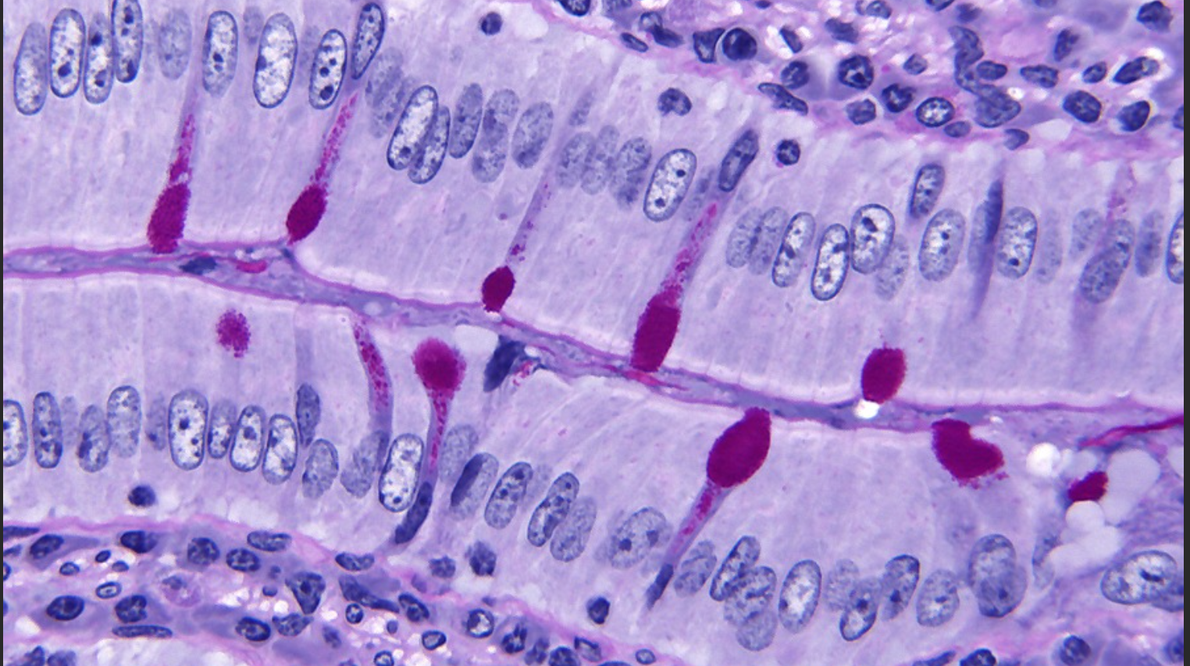
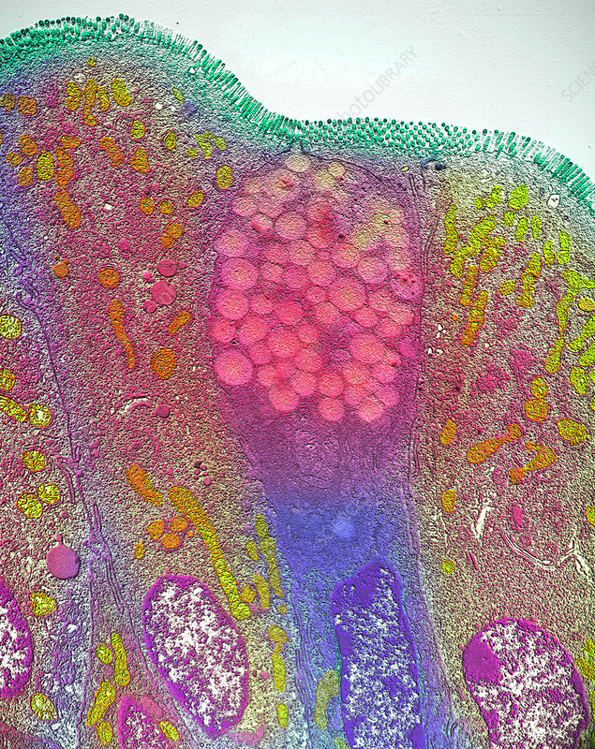
Goblet cells – these line the airways and secrete mucus in order to trap any microorganisms and dust particles which have been inhaled. It helps prevent them reaching the alveoli.
Cilia – lining the airway’s cells, cilia work to wiggle / sweep the mucus towards the throat to be swallowed, alway from the alveoli. This is efficient at preventing lung infections.

Slide 9
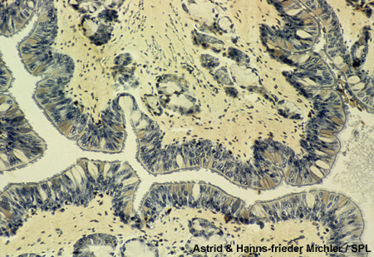
mucus黏液
produced by goblet cells
• mucus is a slimy黏滑的 solution of mucin which is composed of glycoproteins with many carbohydrate chains
• mucus is also made by mucous glands beneath the epithelium
cleaning air
nasal hair filter particles
goblet cells secrete mucus
ciliated cells beat rhythmically to move mucus up the throat
mucus is swallowed – pathogens are destroyed by stomach acid

Slide 10
Elastic fibres in trachea, bronchi, bronchioles、alveoli walls
• stretch during inspiration吸气，recoil during expiration呼气： fibres recoil/elastic recoil弹性后坐力
• elasticity allows alveoli to expand according to volume of air breathed in
also contain some collagen fibres to provide support and help prevent alveoli from bursting.

Slide 11
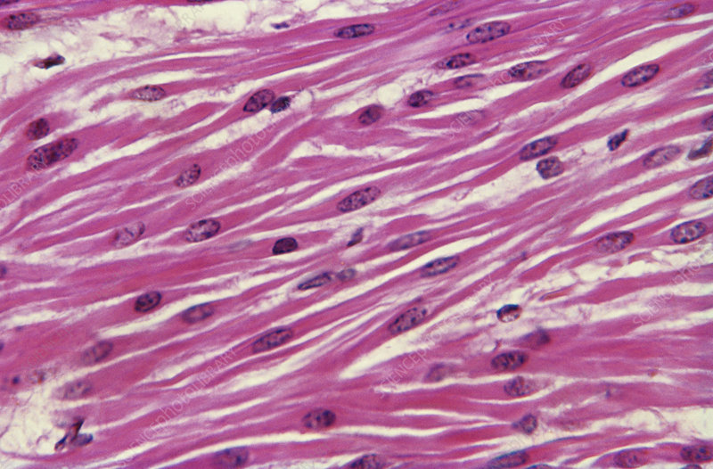
Smooth muscle – to be able to control the diameter of the trachea, bronchi and bronchioles, smooth muscle is around in their walls. These relax during exercise to be able to expand the tubes, giving less resistance to airflow, letting the air move in and out of the lungs more easily.

Slide 12
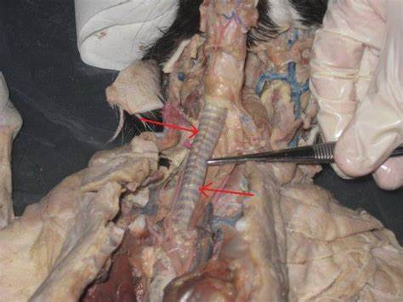
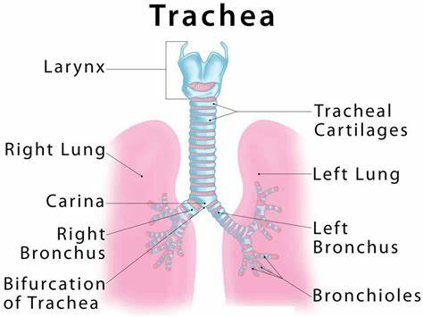
cartilage – these provide support to the walls of the trachea and bronchi. Whilst strong, it is also flexible in order to strop collapsing when breathing in (and the pressure drops).

Slide 13
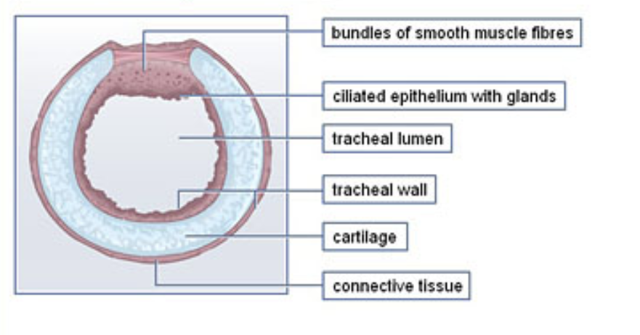
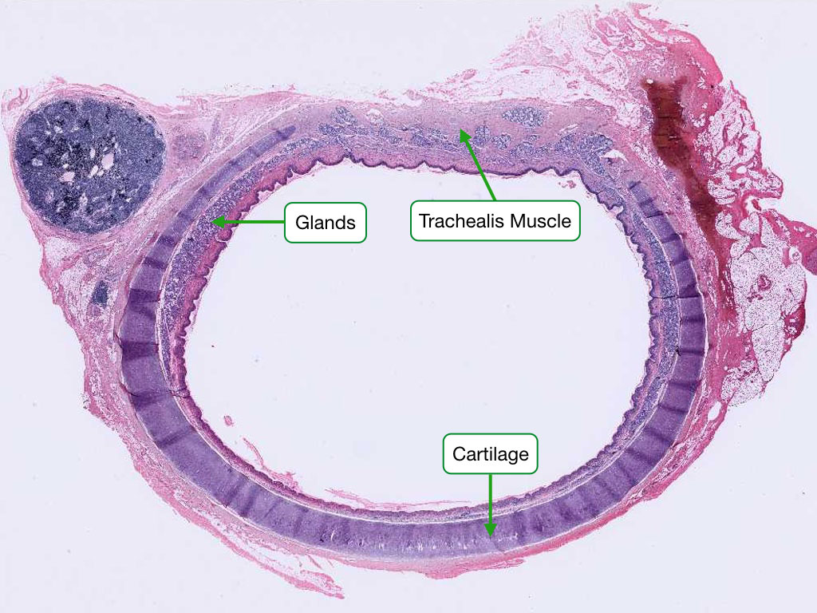
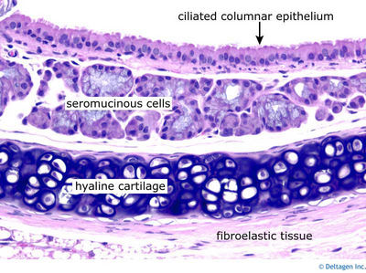
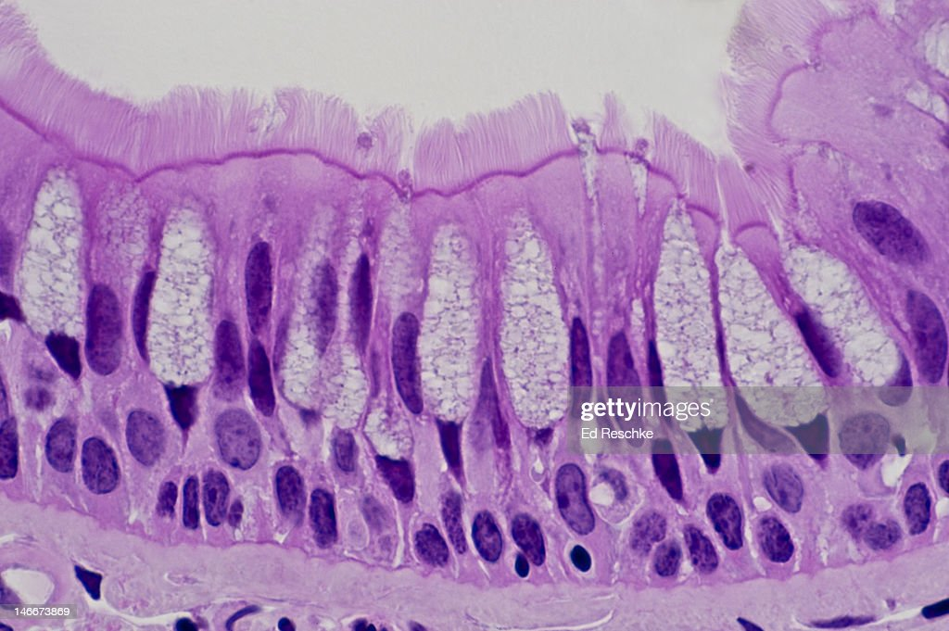
Trachea 气管

Slide 14
Trachea
This is also called the windpipe. This tube runs from the throat towards the bronchi.
The outer layer is made of Cartilage（C-shaped）
middle layer is composed of Glands and Connective Tissues, Smooth Muscle, Elastic Fibres
inner lining of the trachea is a layer of Ciliated Epithelium containing Goblet Cells

Slide 15
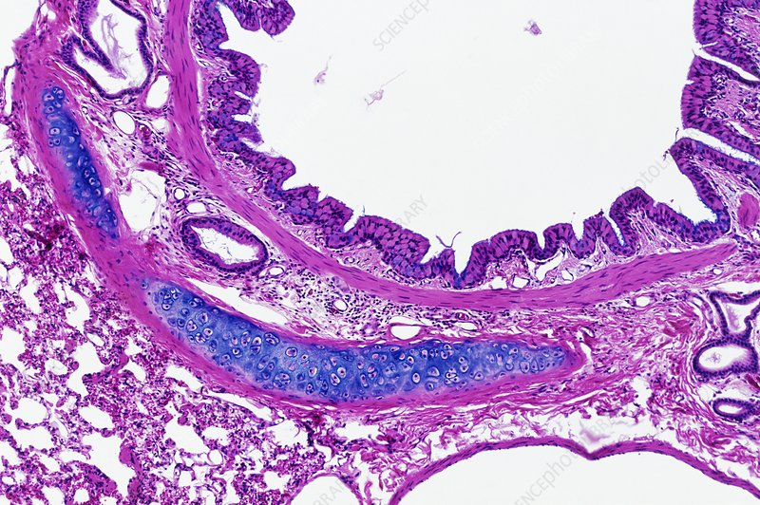
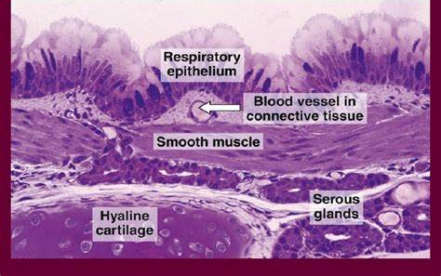
Bronchus支气管
at the base of the trachea and have a similar structure to it
narrower
There are fewer goblet cells per cm² than in the trachea
the epithelial cells are not as tall.
Blocks of cartilage, not rings, support the bronchus

Slide 16
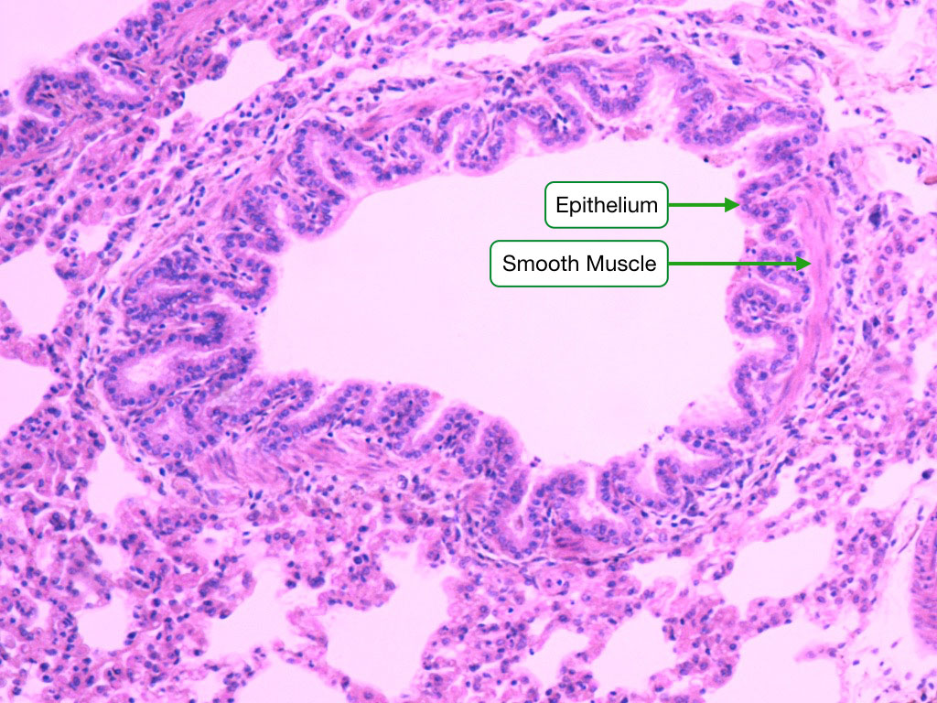
bronchiole细支气管
very narrow tubes (<1mm) that carry air from the bronchi to the alveoli
Surrounding the epithelium is smooth muscle.
There is no cartilage.
Around the bronchiole are some alveoli.
In living lung tissue there is no folding of the wall of the airways.
Smooth muscle contracts at death to cause the folding you can see
Notes:
外部空白部分是肺泡

Slide 17
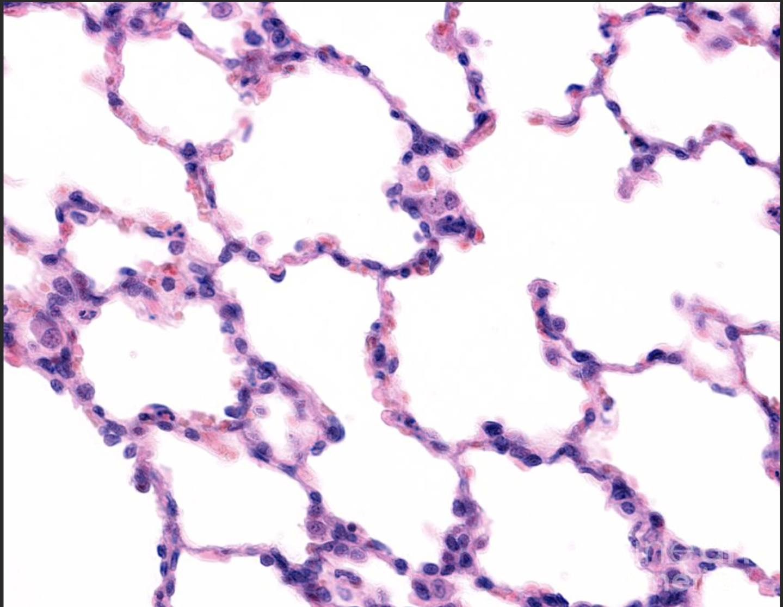
alveoli
main site of gas exchange in the lungs
tiny sacs made of single layer of epithelium cells
blood vessels

Slide 18
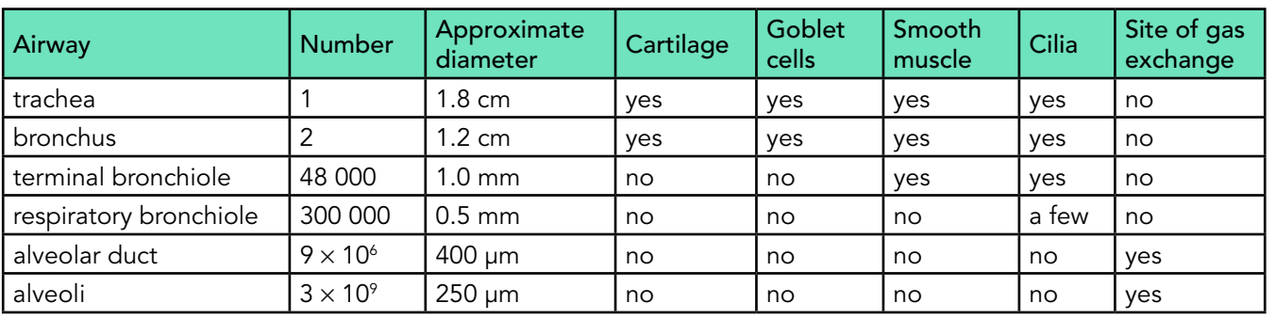

Slide 19
2g – Gas exchange - Humans
Alveoli
Each alveoli is surrounded by blood capillaries.
These carry deoxygenated blood.
The carbon dioxide that is carried by the blood diffuses into the alveoli to be exhaled.
The oxygen diffuses into the blood from the alveoli and binds to the red blood cells.
Deoxygenated blood
Oxygenated blood
Red blood cell
air in and out
Carbon dioxide
Oxygen
Capillary

Slide 20
Gas exchange in the alveoli

Slide 21
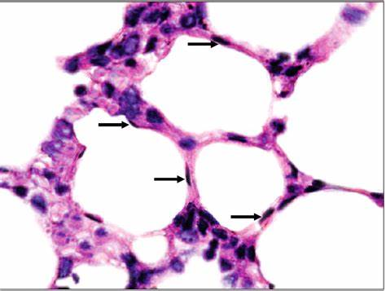
How alveoli are adapted for gas exchange
1) squamous epithelium is one cell thick ， short diffusion distance，large surface area for gas exchange
2) surrounded by a network of capillaries
3) RBC can come very close to air maintaining diffusion gradient
4）permeable wall

Slide 22
Structures of the human lung
Notes:
Photo credit (Q1): Susumu Nishinaga / Science Photo Library
Coloured scanning electron micrograph (SEM) of a bronchiole (yellow) and alveoli (air sacs, pink) in a healthy human lung. The large holes are capillaries running through the alveoli and bronchiole. The bronchiole carries inhaled air from the upper airway to the alveoli in the lung. The alveoli are the sites of gaseous exchange; oxygen enters the blood and carbon dioxide leaves.
Photo credit (Q2): Susumu Nishinaga / Science Photo Library
Coloured scanning electron micrograph (SEM) of mucus-producing cells (orange, round) and cilia (yellow) lining a bronchus (lung airway). Mucus secreted here traps bacteria, dust and other particles. Rhythmic movements of the cilia serve to move the mucus and the trapped particles away from the gas-exchanging parts of the lung, and towards the throat, where they can be expelled.
Photo credit (Q3): Eye Of Science / Science Photo Library
Coloured scanning electron micrograph (SEM) of alveoli in a human lung. Each alveolus is a site for gas exchange between the air in the air sac and the blood in adjacent capillaries. Red blood cells (erythrocytes) can be seen through the walls of the alveoli. Oxygen diffuses from the inhaled air across these walls into the red blood cells. It binds with haemoglobin and is delivered to the body's cells for respiration. Carbon dioxide is returned from the cells to the lungs and diffuses out of the blood to be exhaled. Magnification: x300 when printed at 10cm wide.

Slide 23
Notes:
Teacher notes
In ‘Slide Show’ mode, click the name of a section to jump straight to that slide.

Slide 24

Why do we breathe?
Animals need to maintain a concentration gradient across their exchange surfaces so that oxygen will diffuse into the blood and carbon dioxide will diffuse out.
Fish manage this by keeping a continuous stream of oxygenated water moving over their gills.
In animals such as mammals and birds, a concentration gradient is maintained in the alveoli by the mechanism of ventilation.
Notes:
Photo credit: Jupiterimages Corporation
Teacher notes
See the ‘Transport Across Membranes’ presentation for more information about diffusion and concentration gradients.

Slide 25
The mechanism of ventilation

Slide 26
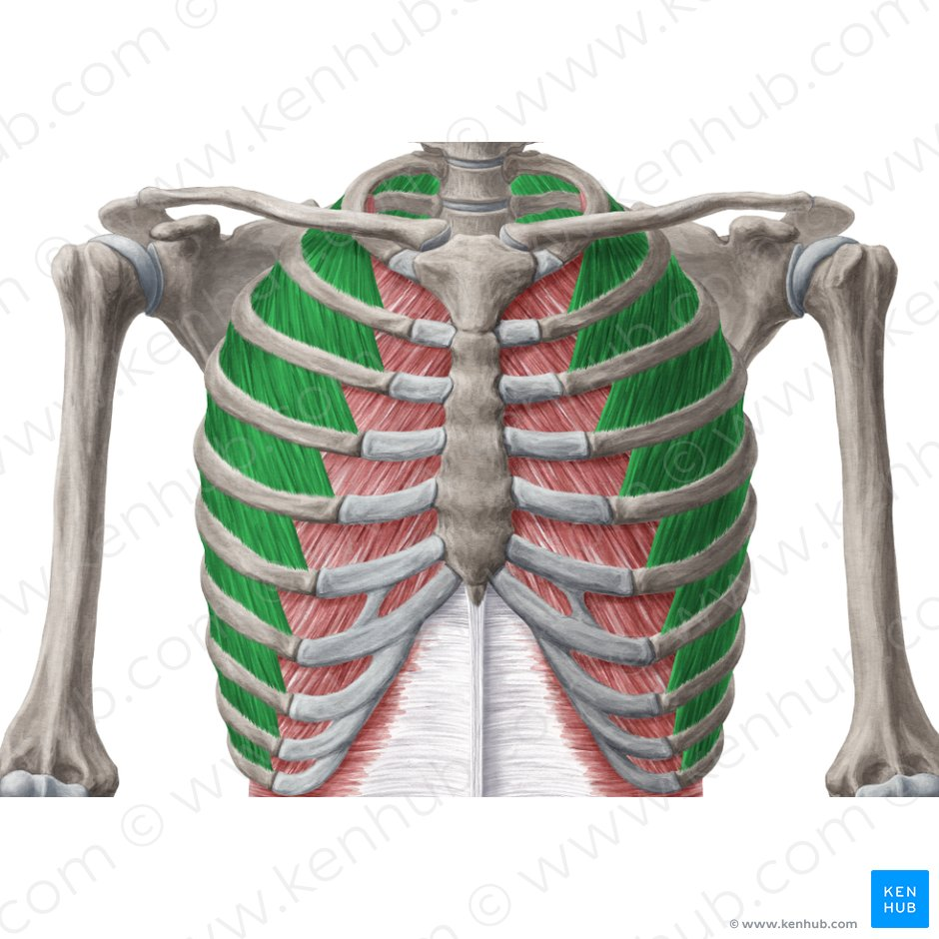
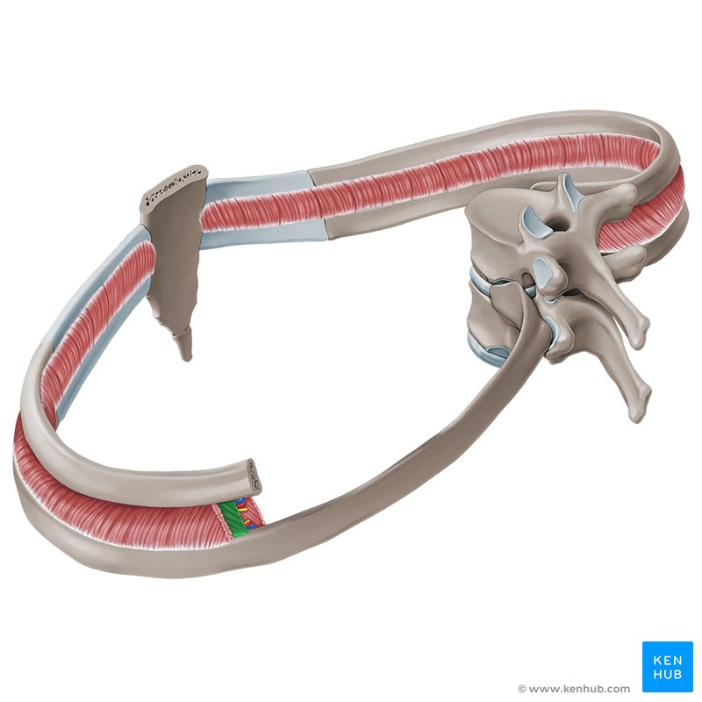
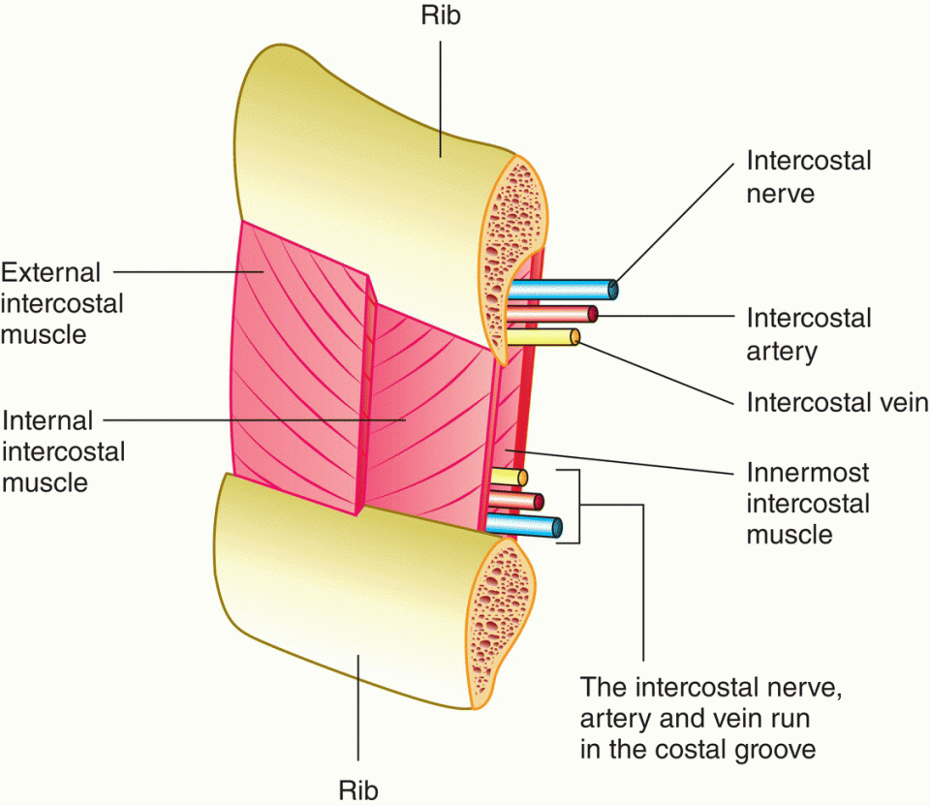
External intercostal muscles
肋间外肌
Internal intercostal muscles
肋间内肌

Slide 27
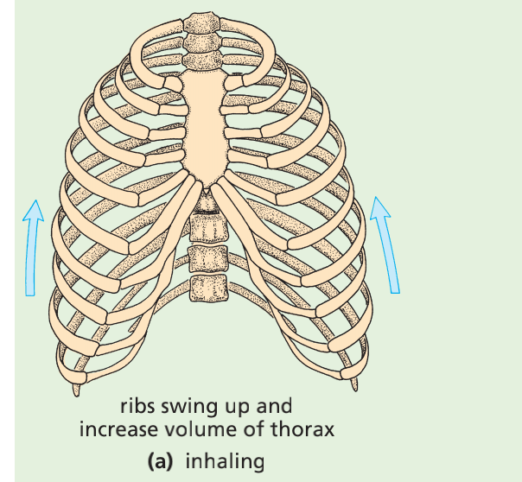
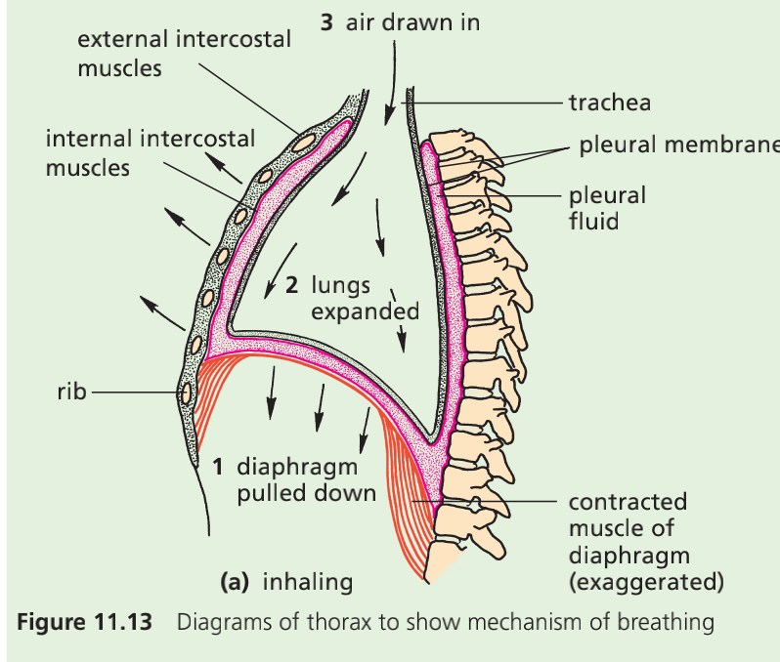
2g – Gas exchange - Humans
Ventilation
Inhaling/inspiration吸气
1 The diaphragm muscles contract and lower
2 The the external intercostal muscles contract，internal intercostal muscles relax
3 Ribcage胸腔 upwards and outwards.
4 Lungs expand

Slide 28
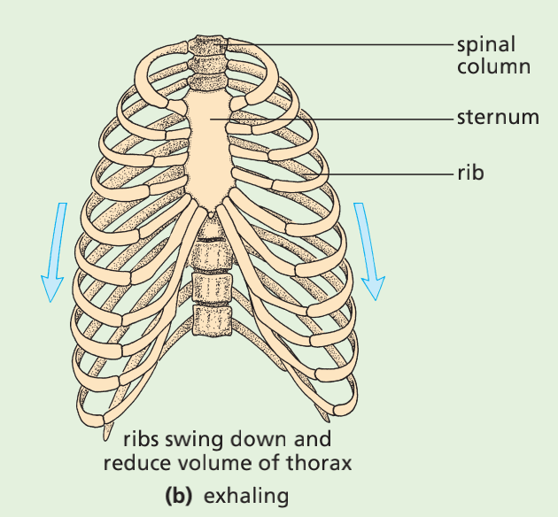
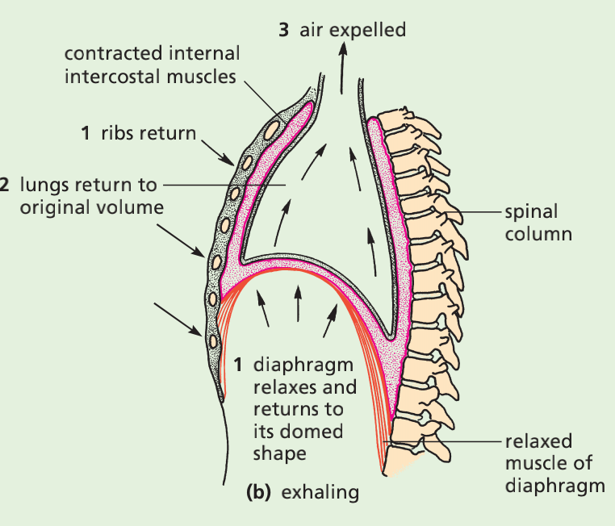
2g – Gas exchange - Humans
Ventilation
Exhaling/expiration呼气
1 The diaphragm muscles relax, diaphragm springs up腾起
2 The external intercostal muscles relax, while the
internal intercostal muscles contract,
3 Ribs downwards
4 The lungs are shrink
Notes:
Net movement

Slide 29
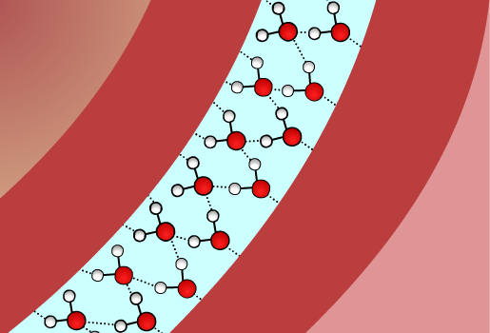
The pleural cavity
Each of the lungs is enclosed in a double membrane known as the pleural membrane. The space between the two membranes is called the pleural cavity, and is filled with a small amount of pleural fluid.
lung
This fluid lubricates the lungs.
pleural membranes

Slide 30
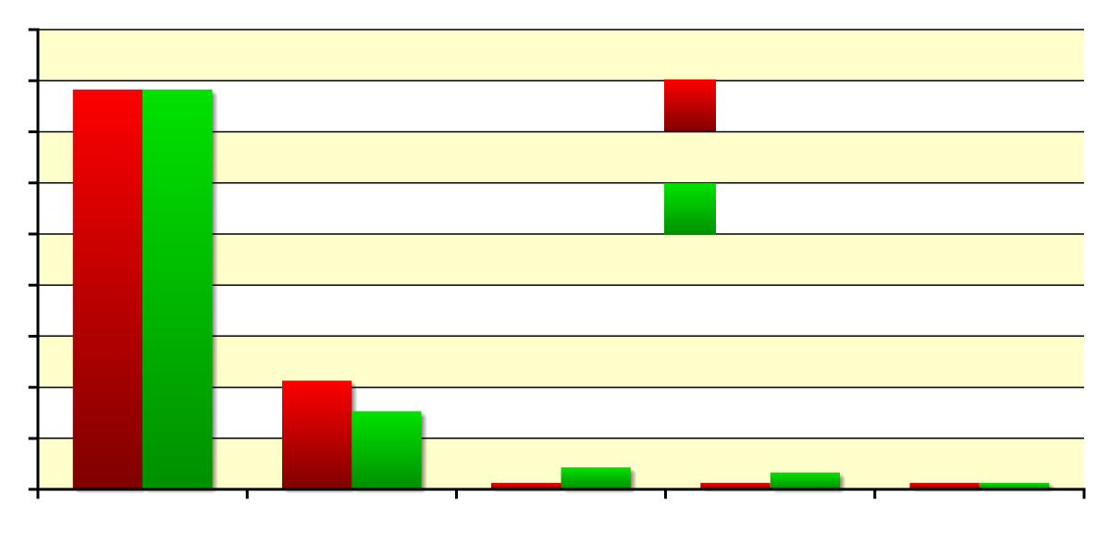
Composition of inhaled/exhaled air
In one breathing cycle, the air in the lungs loses only some of its oxygen content. This is why mouth-to-mouth resuscitation can be effective.
90
78%
78%
80
inhaled air
70
60
exhaled air
50
composition (%)
40
30
21%
15%
20
10
0.04%
4%
<1%
3%
<1%
<1%
0
N₂
O₂
CO₂
H₂O
other
Notes:
Teacher notes
Students could be asked to explain the differences in composition of inhaled and exhaled air.
nitrogen: remains the same because it is not used by the body
oxygen: decreases because it diffuses into the bloodstream and used in respiration
carbon dioxide: increases (by a factor of 10) because it diffuses into the lungs from the bloodstream as a waste product of respiration
water: increases because of the moisture within the alveoli
other gases: these include inert gases, such as argon (present in higher concentration than carbon dioxide in inhaled air) and neon, which are not used by the body

Slide 31
Spirometry
Notes:
Teacher notes
See the ‘Lifestyle and Disease’ presentation for more information about the use of spirometry in diagnosing lung disease.

Slide 32
Spirometric terms

Slide 33
Notes:
Teacher notes
In ‘Slide Show’ mode, click the name of a section to jump straight to that slide.

Slide 34
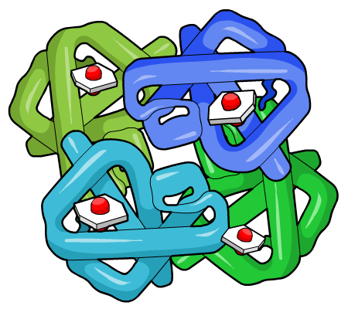
Haemoglobin
Haemoglobin is a protein making up 95% of the dry mass of a red blood cell. It is the means of transport of oxygen around the body.
Haemoglobin is made up of four polypeptide chains, each bound to one haem group.
Each haem group can combine with one oxygen molecule, so that one molecule of haemoglobin can combine with a maximum of four oxygen molecules. This forms oxyhaemoglobin.
polypeptide chain
Notes:
Teacher notes
See the ‘Biological Molecules: Proteins and Lipids’ for more information about the structure of proteins, using haemoglobin as an example.

Slide 35
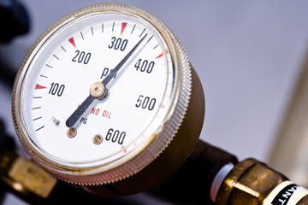
How is oxygen concentration measured?
Oxygen binds to haemoglobin when oxygen is at a high concentration, and dissociates from haemoglobin when oxygen is at a low concentration.
The concentration of a gas in a mixture of gases can be quantified in terms of its partial pressure. This is the amount of pressure exerted by the gas relative to the total pressure exerted by all the gases in the mixture.
Partial pressure is measured in kilopascals (kPa) and is written as P(O₂), P(CO₂), etc.
Notes:
Photo credit: Jupiterimages Corporation
Teacher notes
When a gas is dissolved in a liquid, as is the case with gas transport in blood, the partial pressure is slightly more complex. In this case, the liquid is treated as if it were in equilibrium with a gas phase, and the partial pressures are those that would be exerted by the gases in that phase.

Slide 36
The oxygen dissociation curve

Slide 37
Factors affecting oxygen dissociation

Slide 38
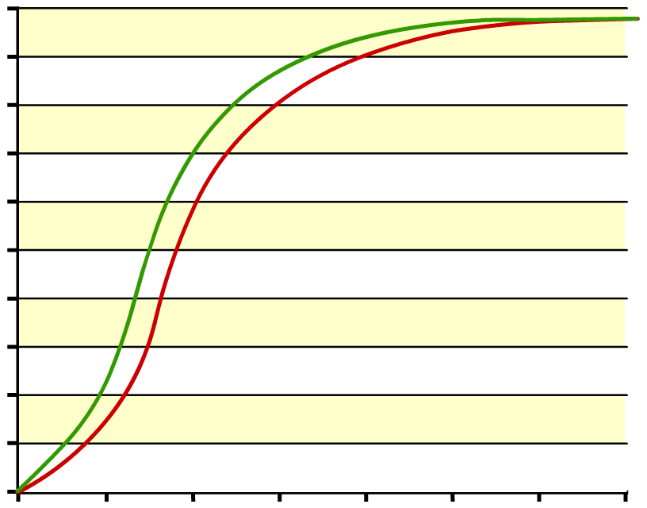
Foetal haemoglobin
The red blood cells in the foetal bloodstream contain a special form of haemoglobin known as foetal haemoglobin.
Foetal haemoglobin has a higher affinity for oxygen than adult haemoglobin.
foetal haemoglobin
100
90
80
70
adult haemoglobin
60
This helps maximize oxygen uptake from the mother’s blood stream, which has already lost some of its oxygen by the time it reaches the placenta.
oxyhaemoglobin (% saturation)
50
40
30
20
10
0
0
2
4
6
8
10
12
14
oxygen partial pressure (kPa)

Slide 39
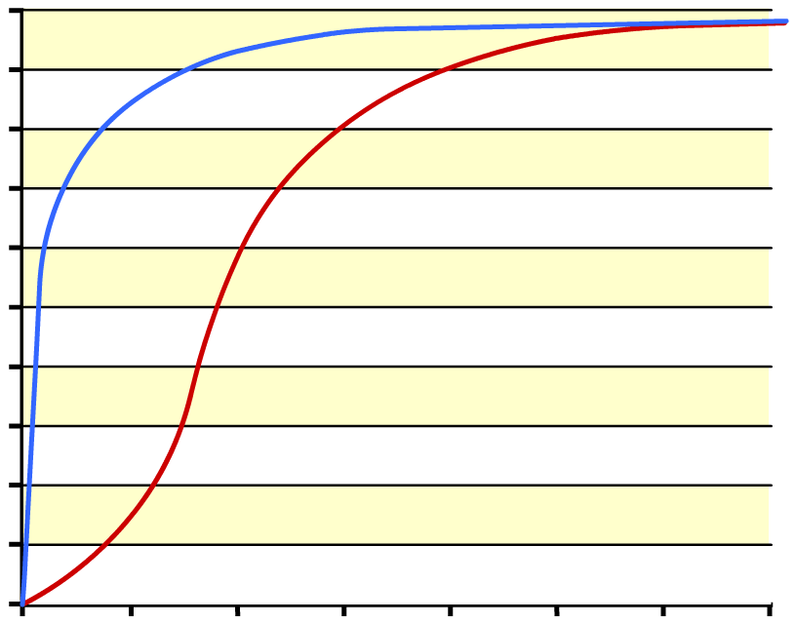
What is myoglobin?
Myoglobin is a molecule with a similar structure to haemoglobin, but with only one haem group.
Myoglobin has a very high affinity for oxygen, even at very low partial pressures.
myoglobin
100
90
80
70
haemoglobin
60
oxyhaemoglobin (% saturation)
This means oxymyoglobin will only dissociate when oxygen levels are low. It is found in muscle cells, where it acts as an oxygen reserve.
50
40
30
20
10
0
0
2
4
6
8
10
12
14
oxygen partial pressure (kPa)

Slide 40
Understanding oxygen transport

Slide 41
Notes:
Teacher notes
In ‘Slide Show’ mode, click the name of a section to jump straight to that slide.

Slide 42
Glossary

Slide 43
What’s the keyword?

Slide 44
Structures involved in gas exchange

Slide 45
Multiple-choice quiz

